Slide 1
Quantum Computing Architectures (EE274) Lecture 28
Hiu-Yung Wong
MAy 8, 2025
hiuyung.wong@sjsu.edu, Office: ENG363
http://www.sjsu.edu/people/hiuyung.wong/index.html

Slide 2
Outline
Trapped Ion Qubits

Slide 3
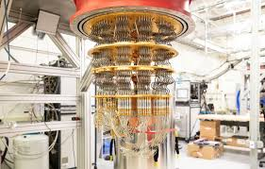
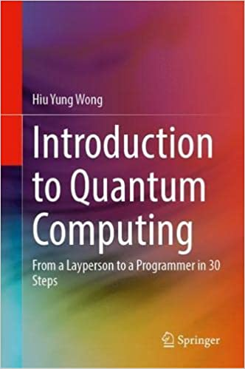
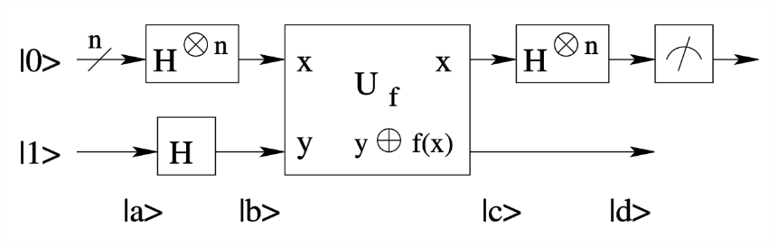

Fall 2025: EE 225 Introduction to Quantum Computing
Email: hiuyung.wong@sjsu.edu
(Prerequisites Graduate Students or Instructor Consent, undergraduate students are welcome!!)
A pedestrian guide on:
Quantum Gates and Circuits
Quantum Computing Algorithms
Quantum Programming
Run your program on real quantum computer (IBM-Q)
Video from previous classes
New Specialization in EE Master Degree:
Quantum Computing and Information (any 3)
This class (EE225)
EE226 Cryogenic Electronics
EE222 Advanced Integrated Devices
EE274 Quantum Computing Architectures

Slide 4
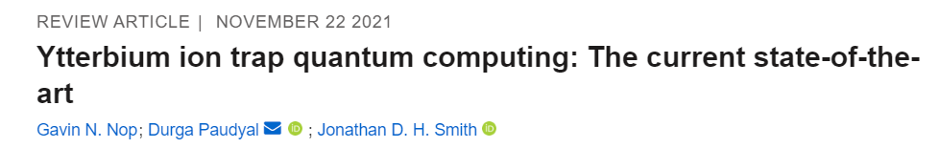
Trapped Ions
Atomic Physics, Foot

Slide 5
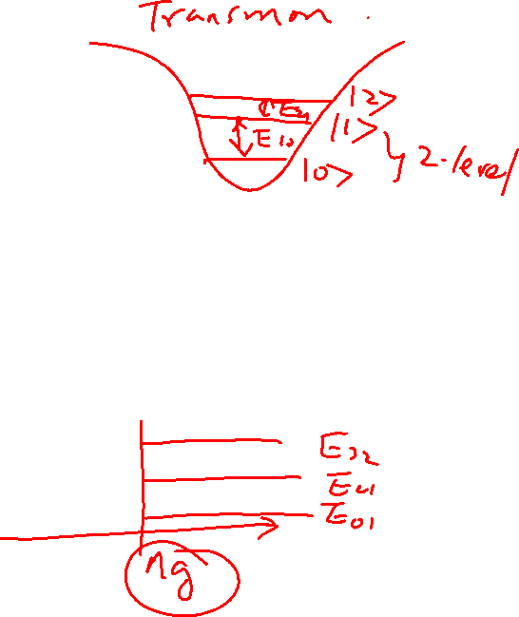
DiVincenzo's criteria for QC
From the last lecture
5 Necessary Criteria for quantum computing:
A scalable physical system with well characterized qubit (system needs to remain in the subspace of 2 level)
The ability to initialize the state of the qubits to a simple fiducial state (initialization time is important)
Long relevant decoherence times (much longer than gate time)
A "universal" set of quantum gates
A qubit-specific measurement capability (Some algorithms only works without measuring all qubits at the same time e.g. teleportation)

Slide 6
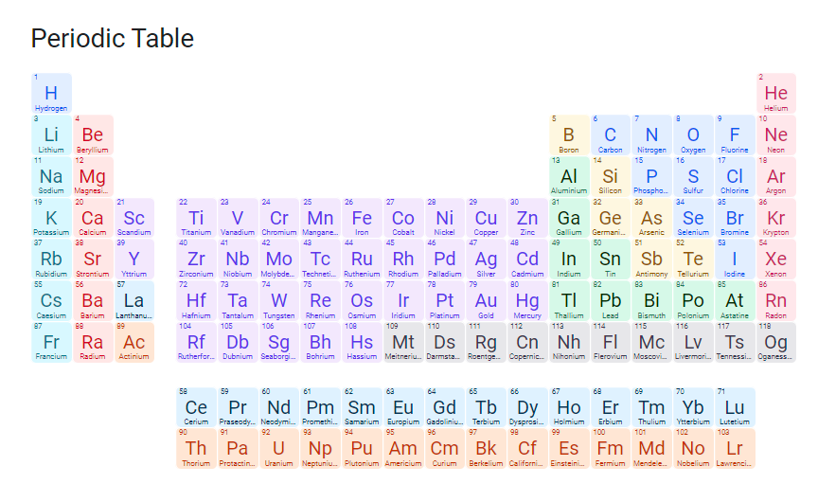
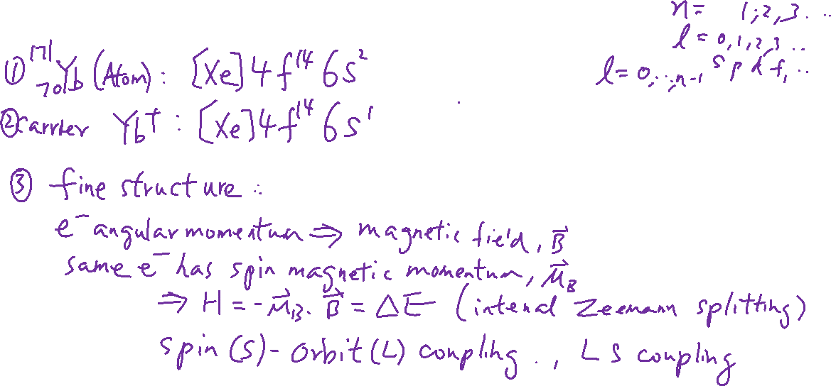
Qubit Carrier
From the last lecture

Slide 7
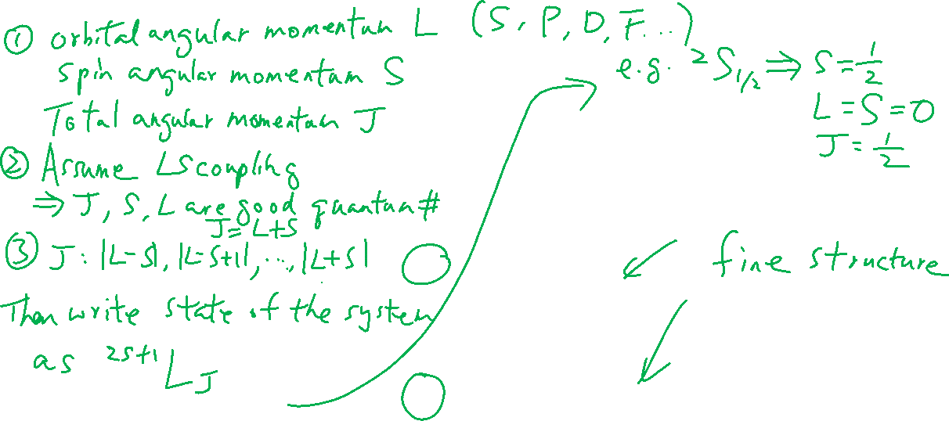
Term Symbol
From the last lecture
¹⁷¹Yb
Vacuum
369.53nm
¹P₁
398.91nm
¹S₀

Slide 8
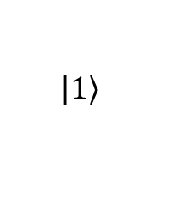
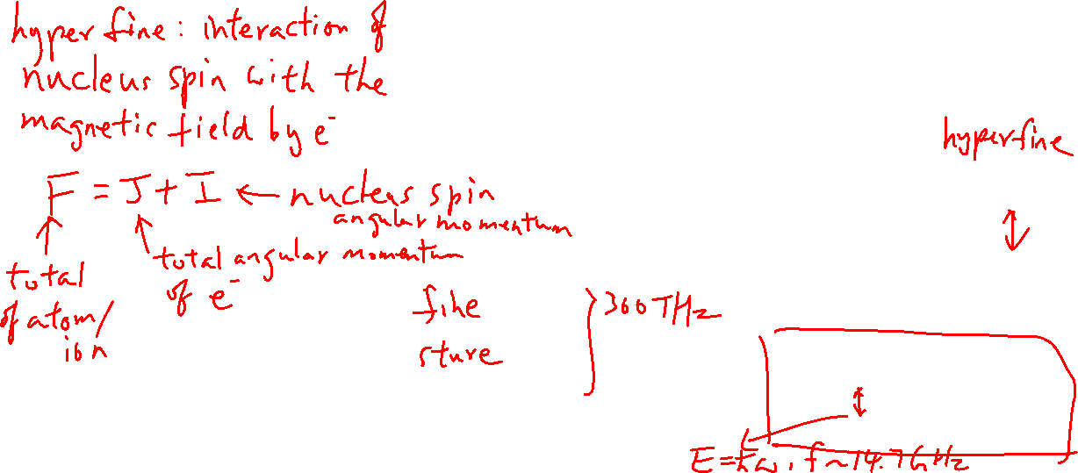
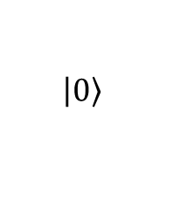
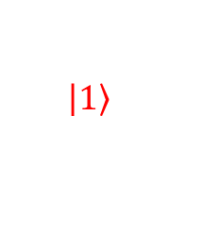


Hyperfine Structure – Well-defined two-level system
From the last lecture
¹⁷¹Yb⁺
¹⁷¹Yb
¹⁷¹Yb⁺
Vacuum
F=1
F=1
369.53nm
²P_{1/2}
Ionization
²P_{1/2}
F=0
¹P₁
F=0
398.91nm
F=1
$$\left.\left|1\right.\right\rangle$$
F=1
$$\left.\left|1\right.\right\rangle$$
Qubit States
²S_{1/2}
F=0
¹S₀
F=0
$$\left.\left|0\right.\right\rangle$$
$$\left.\left|0\right.\right\rangle$$

Slide 9
Why ¹⁷¹Yb⁺?
From the last lecture
171: for ½ nuclear spin
+: for trapping
Has reasonable ionization energy

Slide 10
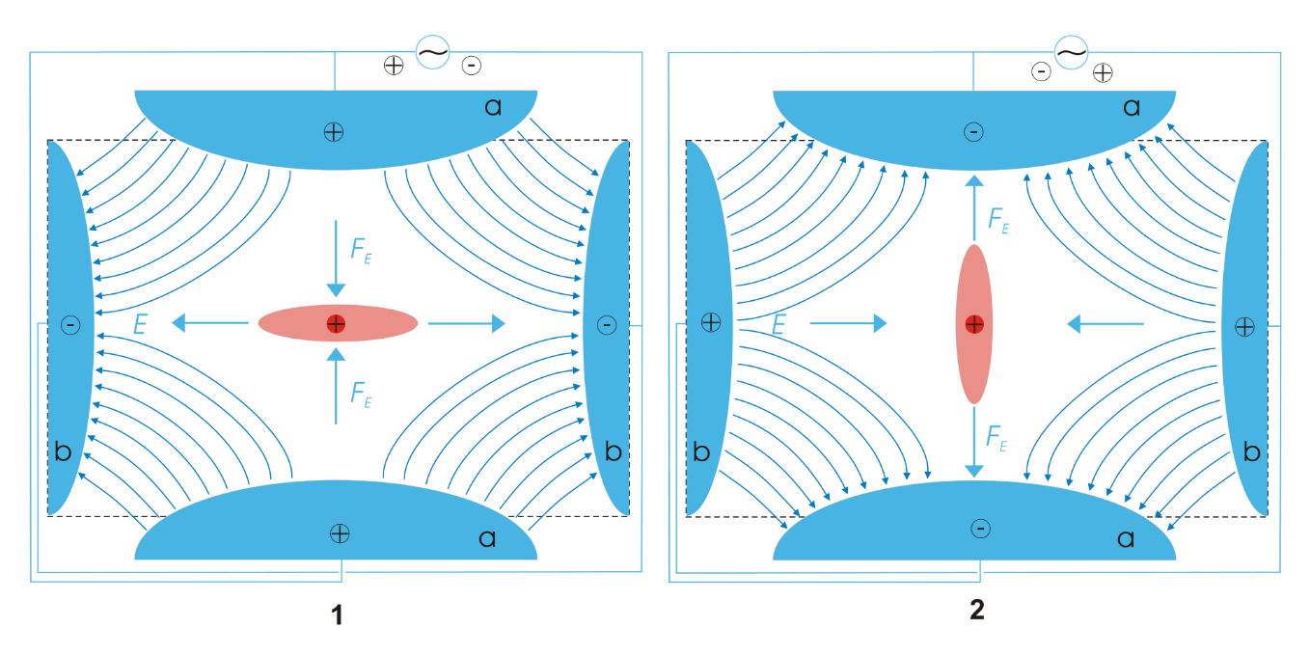
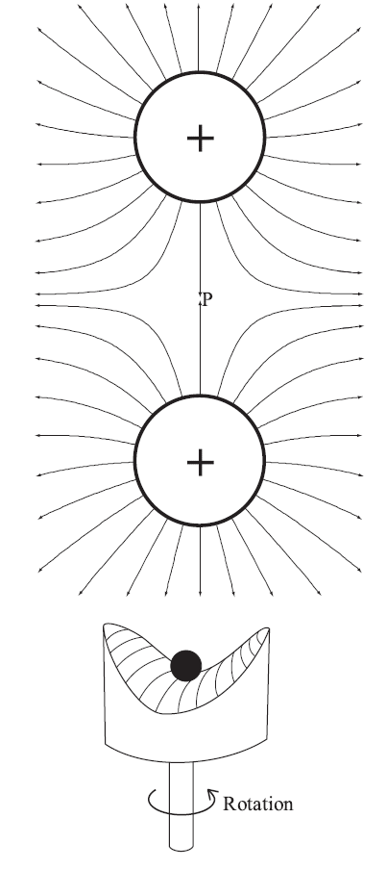
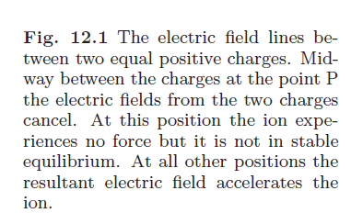
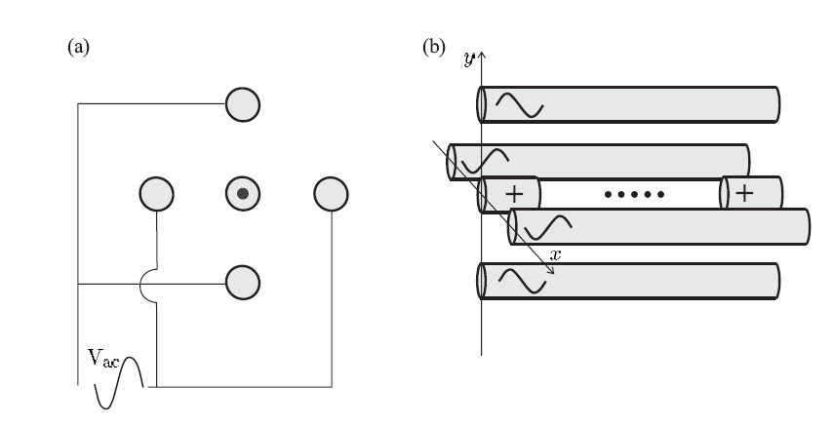
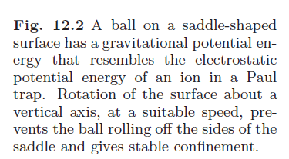
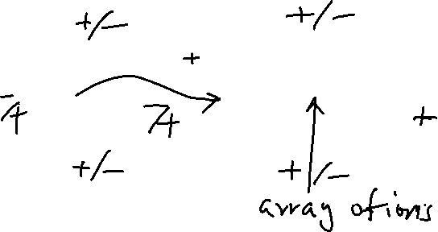
Ion Trapping
From the last lecture
Linear Paul Trap
Atomic Physics, Foot

Slide 11
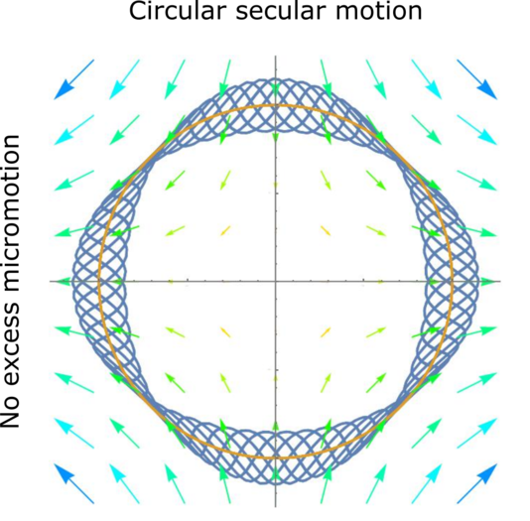
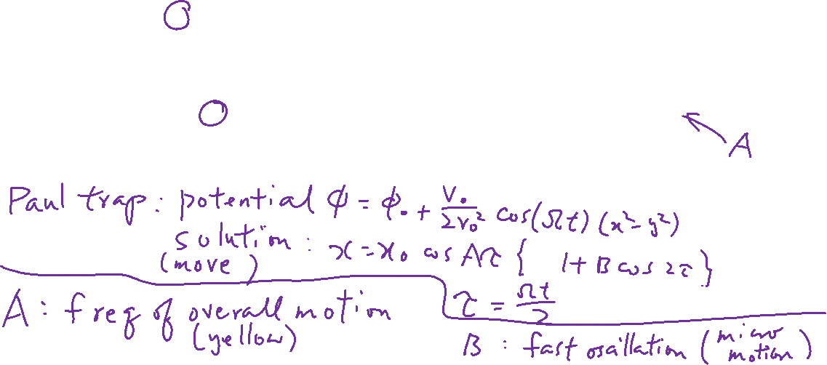
Ion Trapping
From the last lecture
Wiki
Atomic Physics, Foot

Slide 12
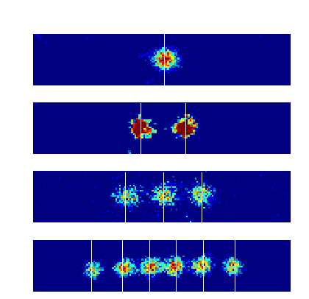
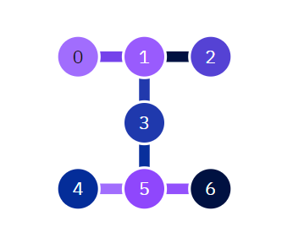
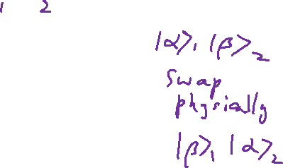
Ion Trapping and SWAP Gate
From the last lecture
Wiki
Due to full qubit connectivity, we can implement SWAP gate using classical action.
Compared to Superconducting qubit QC e.g. IBM_Perth

Slide 13
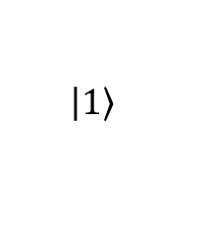
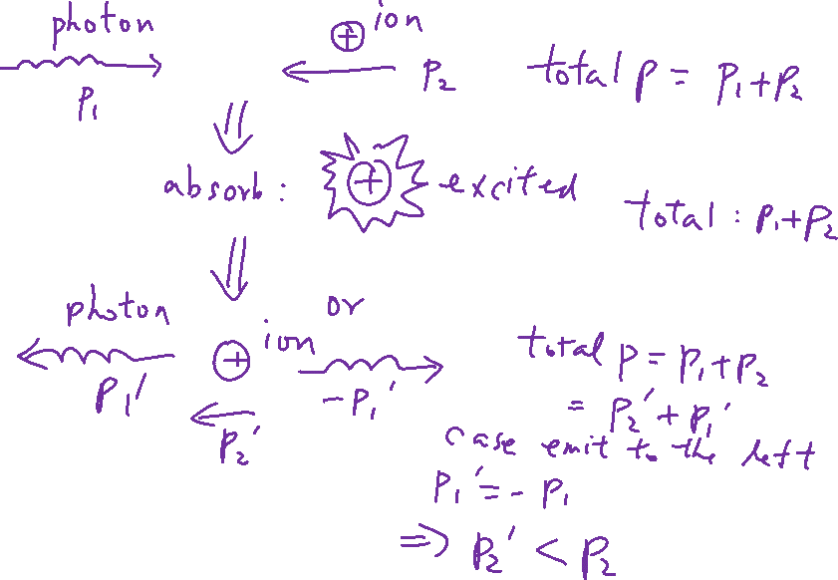
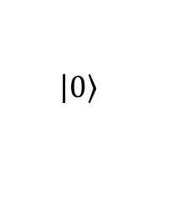


Laser Cooling – Absorption and Emission (Left Moving Ion)
From the last lecture
¹⁷¹Yb⁺
¹⁷¹Yb⁺
F=1
F=1
²P_{1/2}
²P_{1/2}
F=0
F=0
369.53nm
369.53nm
F=1
$$\left.\left|1\right.\right\rangle$$
F=1
$$\left.\left|1\right.\right\rangle$$
Qubit States
²S_{1/2}
F=0
F=0
$$\left.\left|0\right.\right\rangle$$
$$\left.\left|0\right.\right\rangle$$

Slide 14

Laser Cooling – Absorption and Emission (Right Moving Ion)
From the last lecture
¹⁷¹Yb⁺
¹⁷¹Yb⁺
F=1
F=1
²P_{1/2}
²P_{1/2}
F=0
F=0
369.53nm
369.53nm
F=1
$$\left.\left|1\right.\right\rangle$$
F=1
$$\left.\left|1\right.\right\rangle$$
Qubit States
²S_{1/2}
F=0
F=0
$$\left.\left|0\right.\right\rangle$$
$$\left.\left|0\right.\right\rangle$$

Slide 15
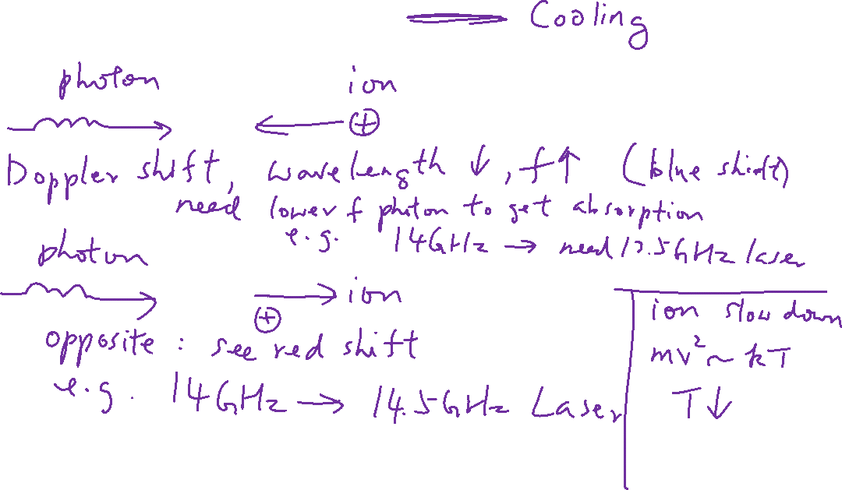
Laser Cooling – Doppler Colling
From the last lecture

Slide 16
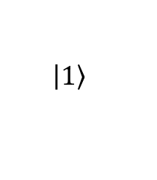
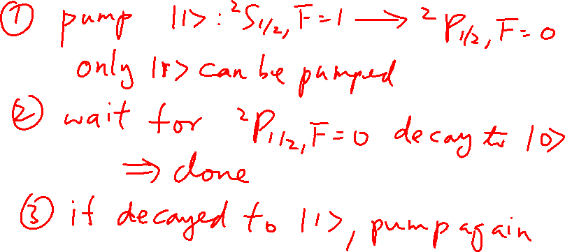
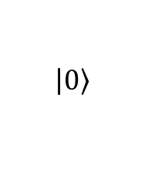


State Preparation (<0.5μs)
From the last lecture
¹⁷¹Yb⁺
¹⁷¹Yb⁺
F=1
F=1
²P_{1/2}
²P_{1/2}
F=0
F=0
369.53nm
369.53nm
F=1
$$\left.\left|1\right.\right\rangle$$
F=1
$$\left.\left|1\right.\right\rangle$$
Qubit States
²S_{1/2}
F=0
F=0
$$\left.\left|0\right.\right\rangle$$
$$\left.\left|0\right.\right\rangle$$

Slide 17
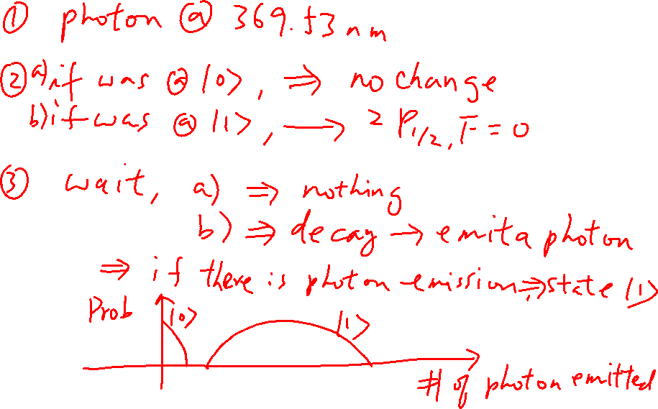
Measurement – Fluorescent Techniques
¹⁷¹Yb⁺
¹⁷¹Yb⁺
F=1
F=1
²P_{1/2}
²P_{1/2}
F=0
F=0
369.53nm
369.53nm
F=1
$$\left.\left|1\right.\right\rangle$$
F=1
$$\left.\left|1\right.\right\rangle$$
Qubit States
²S_{1/2}
F=0
F=0
$$\left.\left|0\right.\right\rangle$$
$$\left.\left|0\right.\right\rangle$$

Slide 18
Trapped Ions: 1-Qubit and 2 Qubit Gates
Atomic Physics, Foot

Slide 19
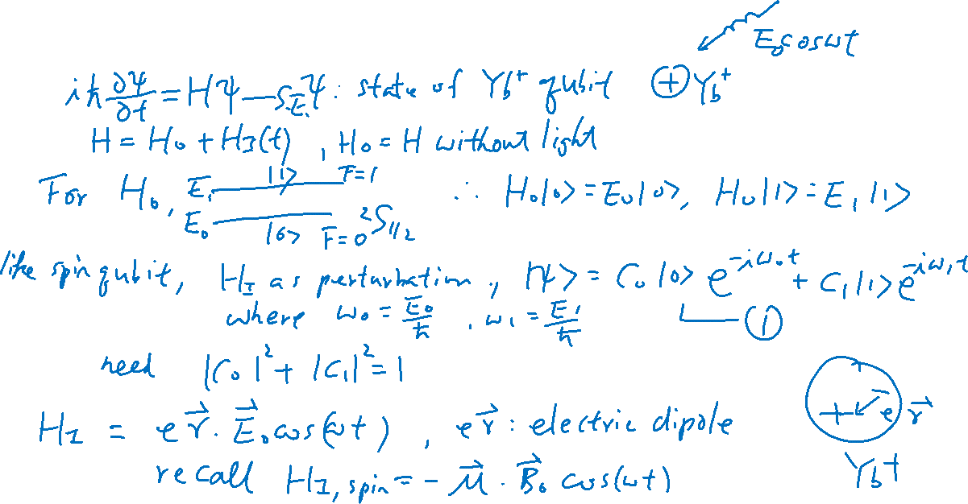
Matter-Light Interaction

Slide 20
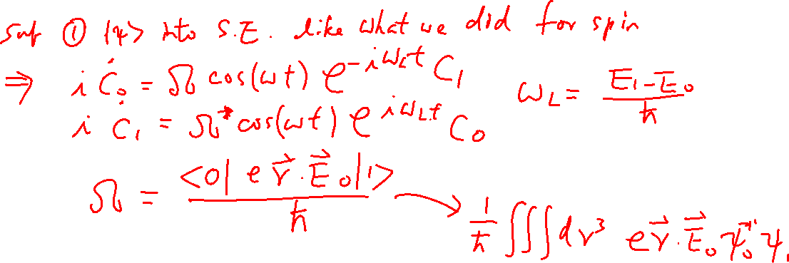
Matter-Light Interaction

Slide 21
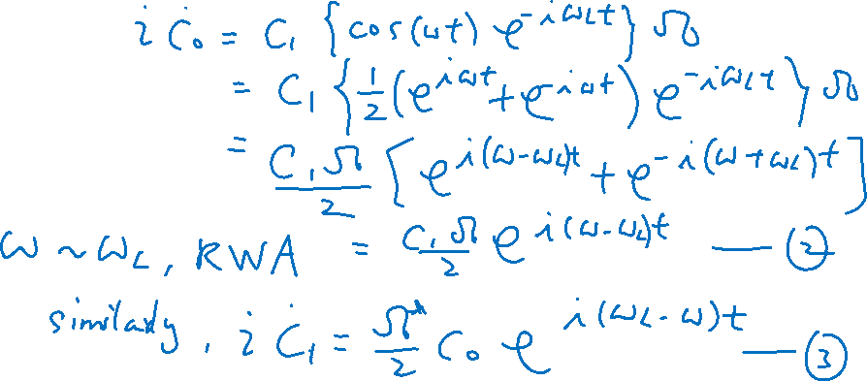
Matter-Light Interaction (Monochromatic Light)

Slide 22
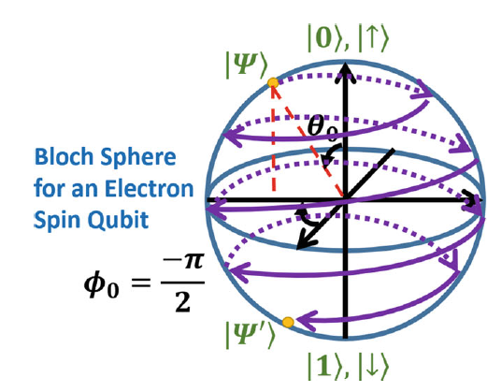
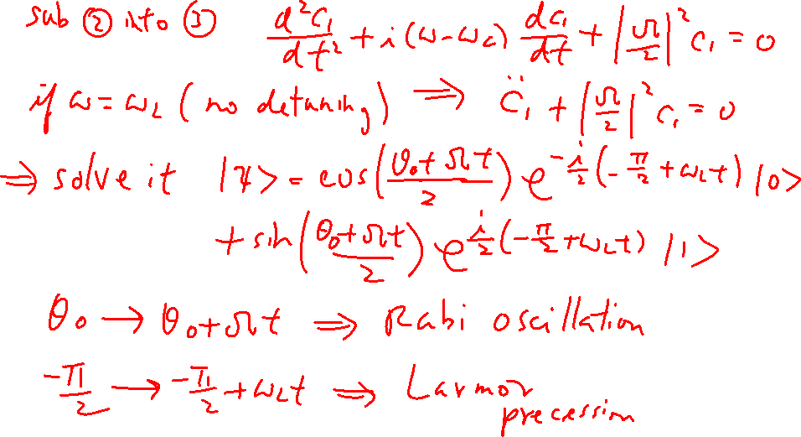
Matter-Light Interaction (Rabi Oscillation)

Slide 23
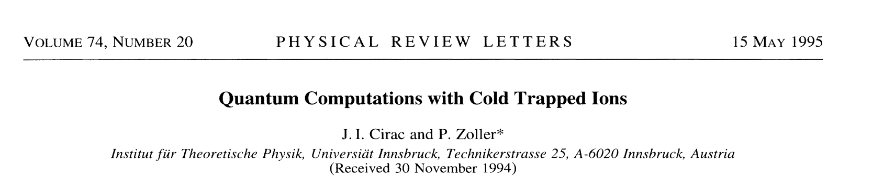
Trapped Ions: 2 Qubit Gates

Slide 24
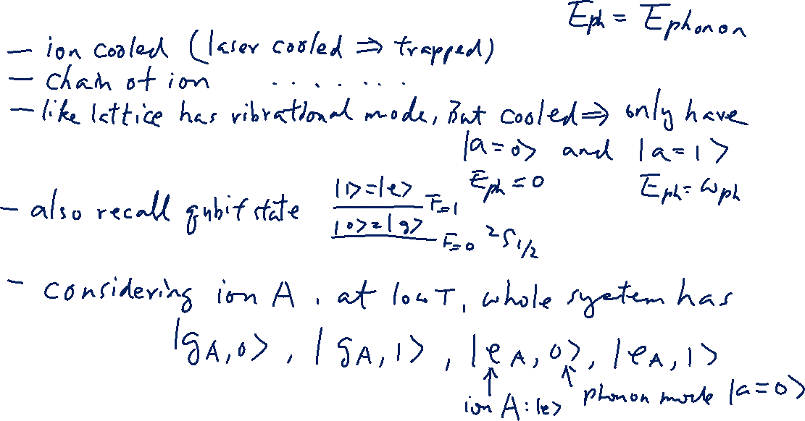
2-qubit gate, Controlled-Z gate (to build: Cirac–Zoller controlled-NOT gate)

Slide 25
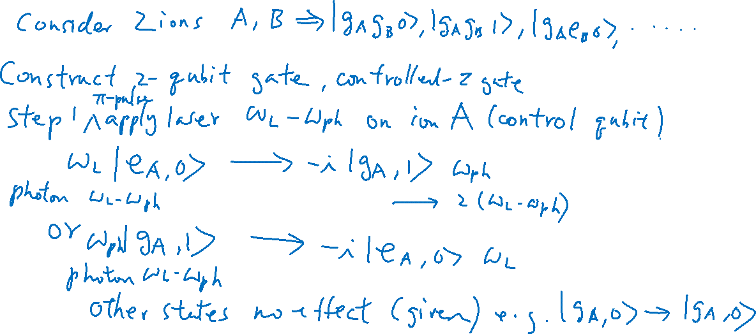
2-qubit gate, Controlled-Z gate (to build: Cirac–Zoller controlled-NOT gate)

Slide 26
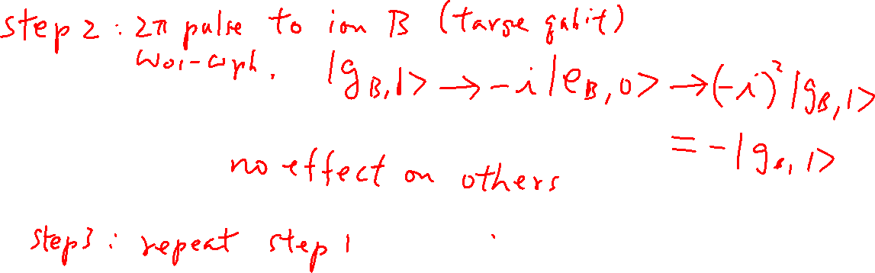
2-qubit gate, Controlled-Z gate (to build: Cirac–Zoller controlled-NOT gate)

Slide 27
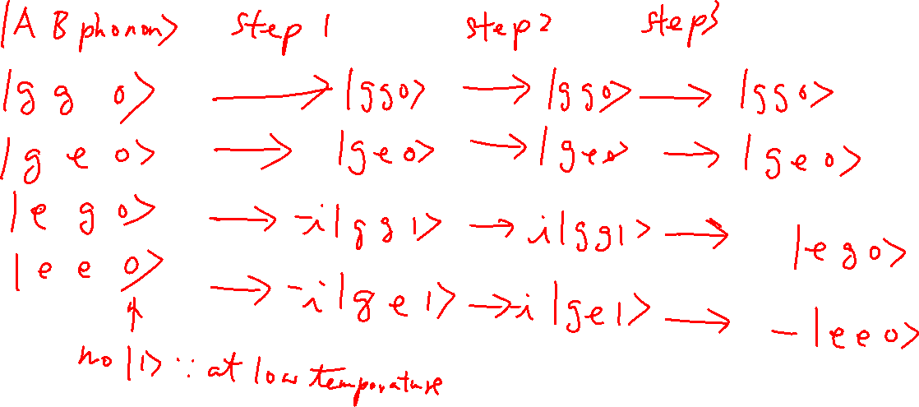
2-qubit gate, Controlled-Z gate (to build: Cirac–Zoller controlled-NOT gate)

